Slide 1
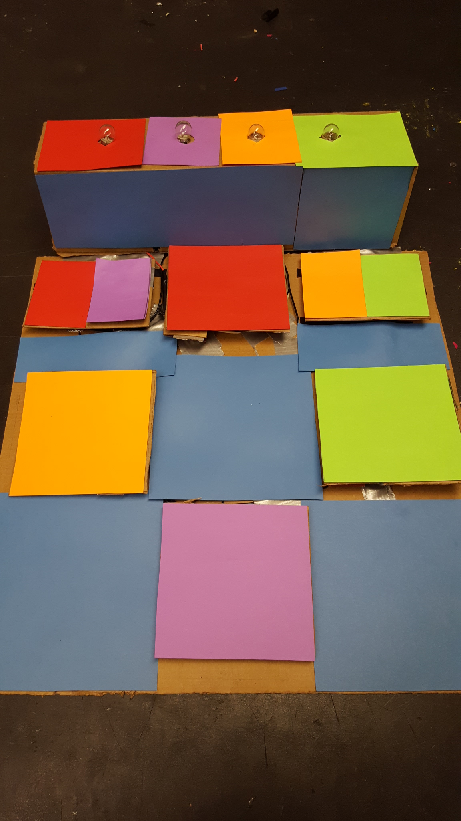
Dance Mania
Will Bridges and Joey Grace

Slide 2
Understand
We started off learning about how electric current and soldering work together in various videos. We also worked on handouts to understand how to complete circuits and the properties of electric current. In terms of the pad itself, we determined the dance pads that a user would step down on act as a switch for the light bulbs. So when someone steps on a pad the switch is activated and the circuit is complete, lighting the bulb.

Slide 3
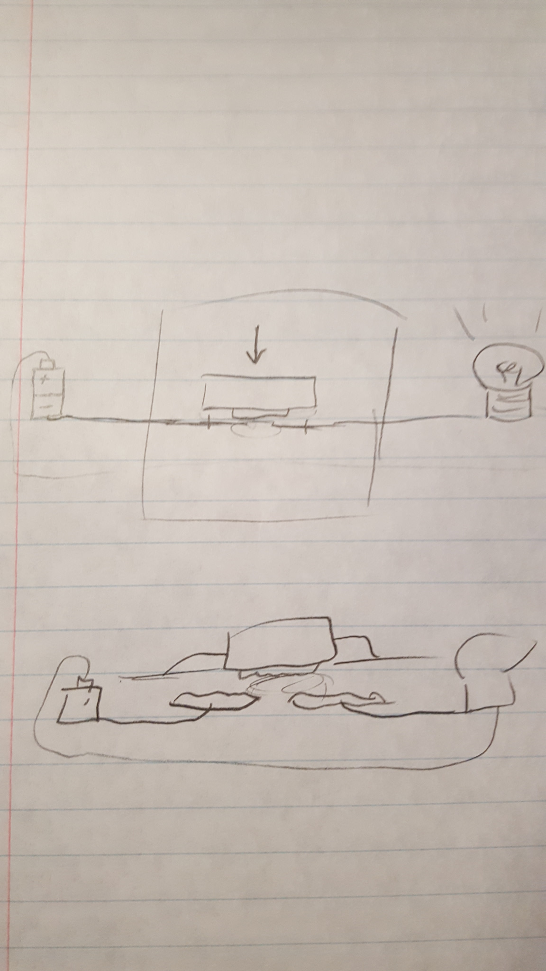
Explore
Below are various ideas we debated while brainstorming
Theme of Dance Pad | Stepping Pad/Switch | How to keep dance pads from staying pushed down
Classic Dancing Video Game (with arrows) | Connecting wires to wires | Using springs
Various Colors | Connecting aluminum to wires | Using bent cardboard
Electronic Theme | Connecting aluminum to aluminum | Using folded paper

Slide 4
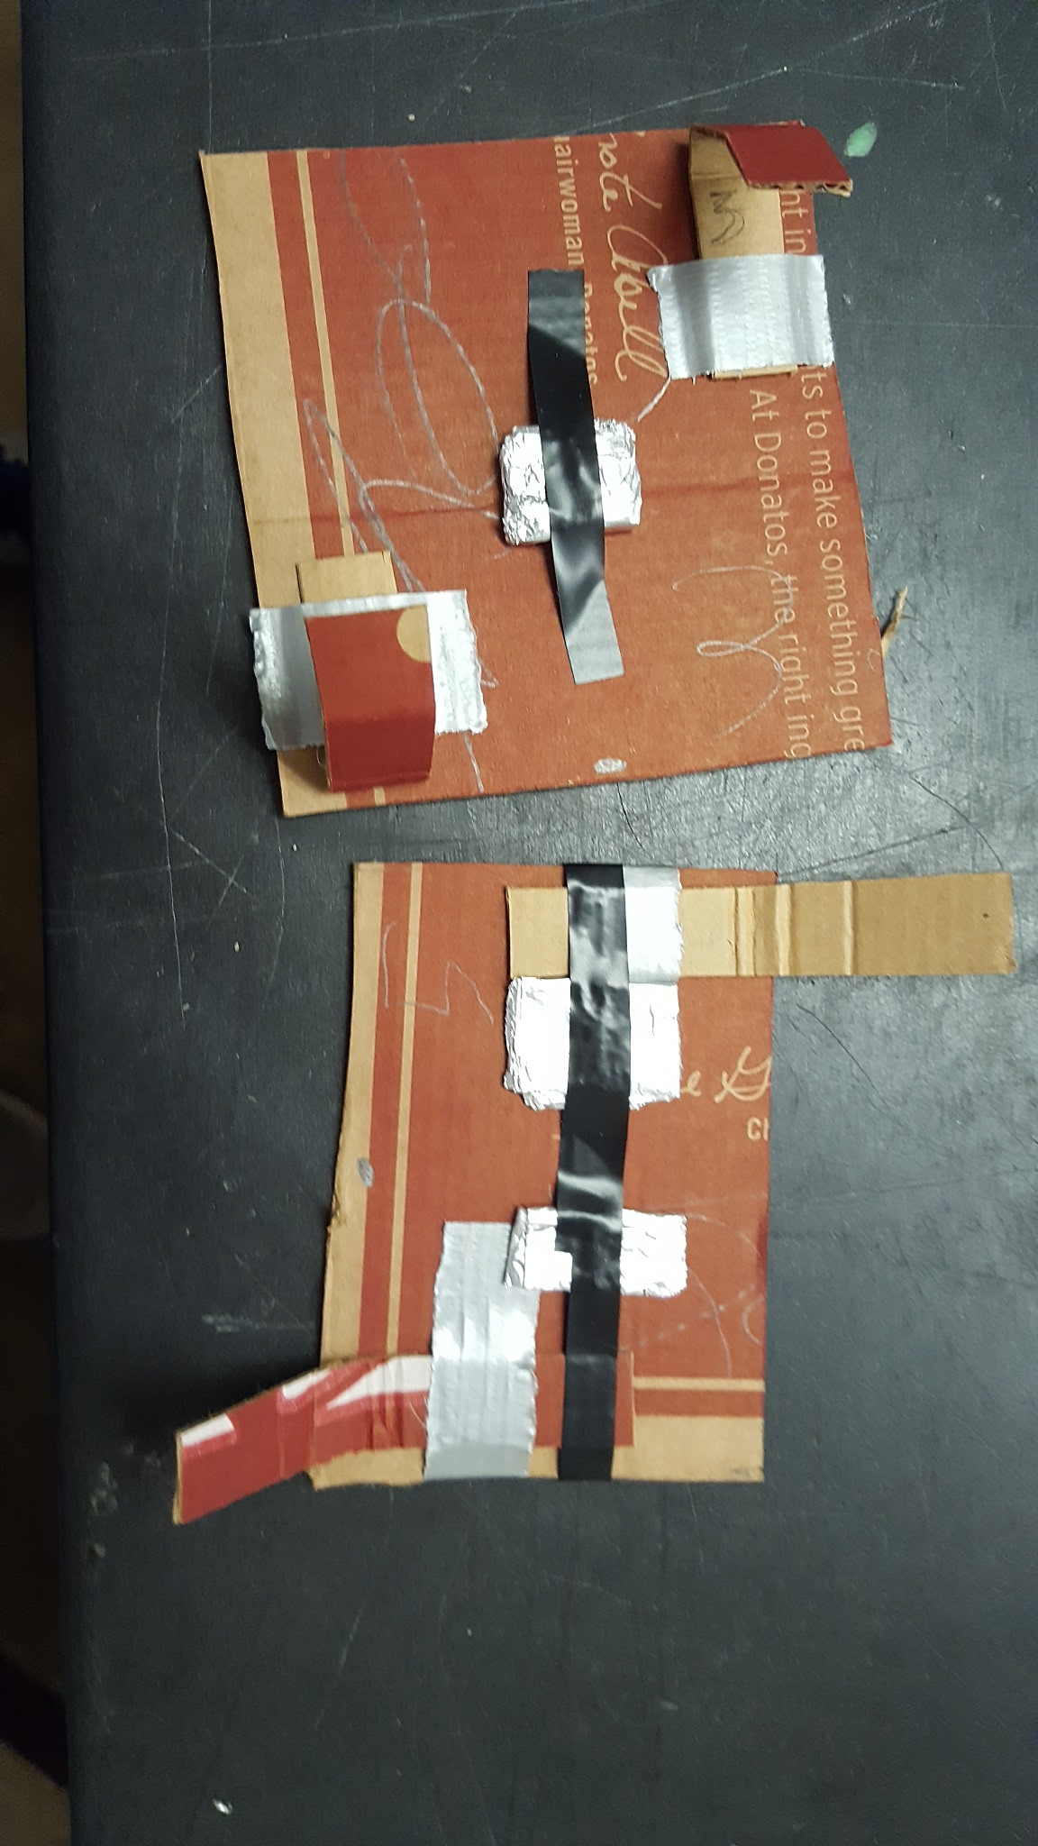
Define
We decided to go with a theme of various colors, and using aluminum foil on aluminum foil to complete circuits when a pad is stepped down on. In addition to that we also decided that carboard would be the best way to make the dance pad move up and down freely when stepped on.
Picture underneath the dance pads that shows the aluminum to complete the circuit and cardboard strips that act to rebound the pad.

Slide 5
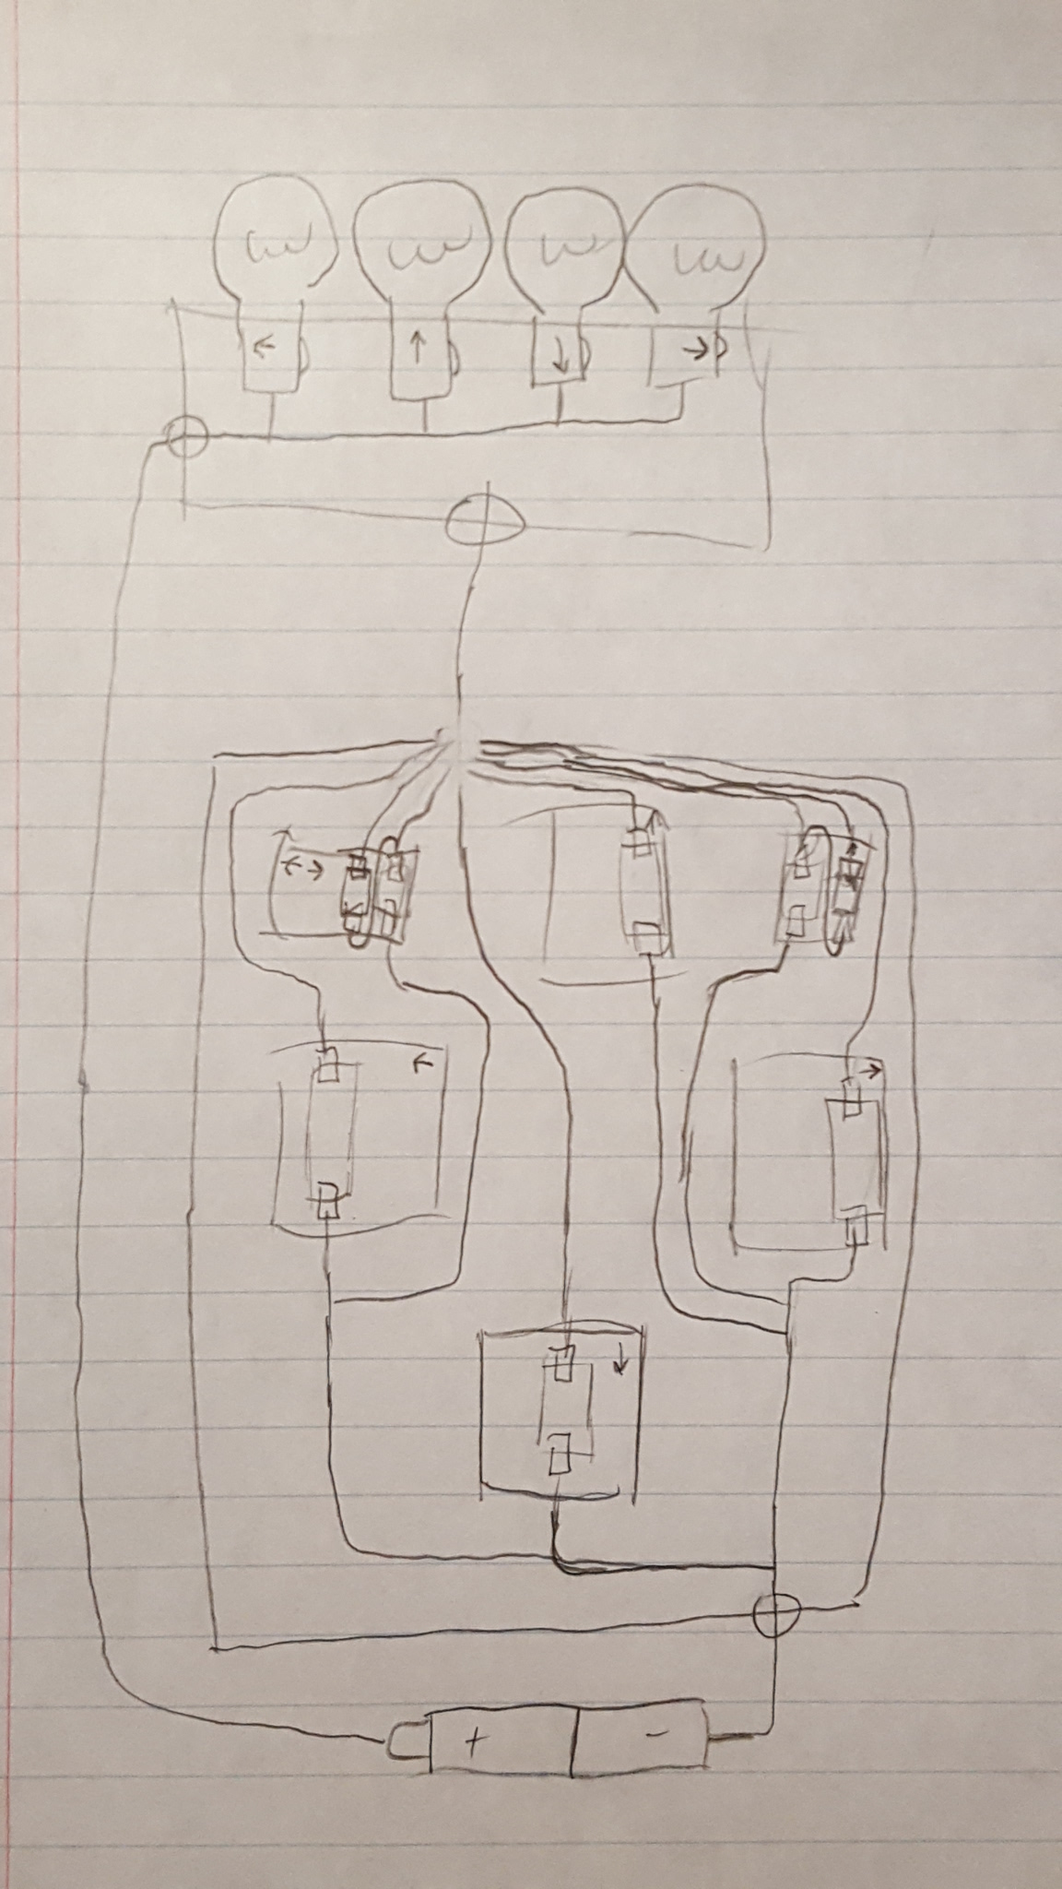
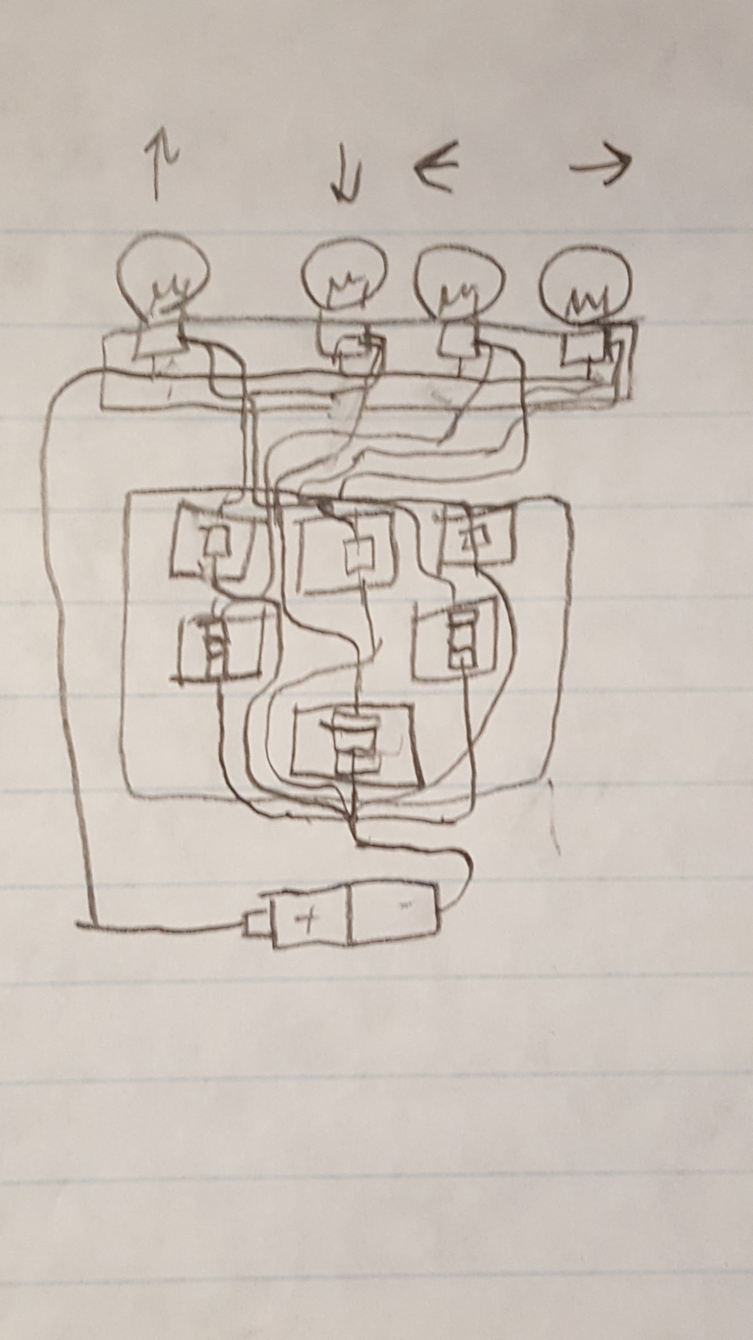
Ideate
We created various models on paper to represent the shape and setup of the pad and lights.

Slide 6
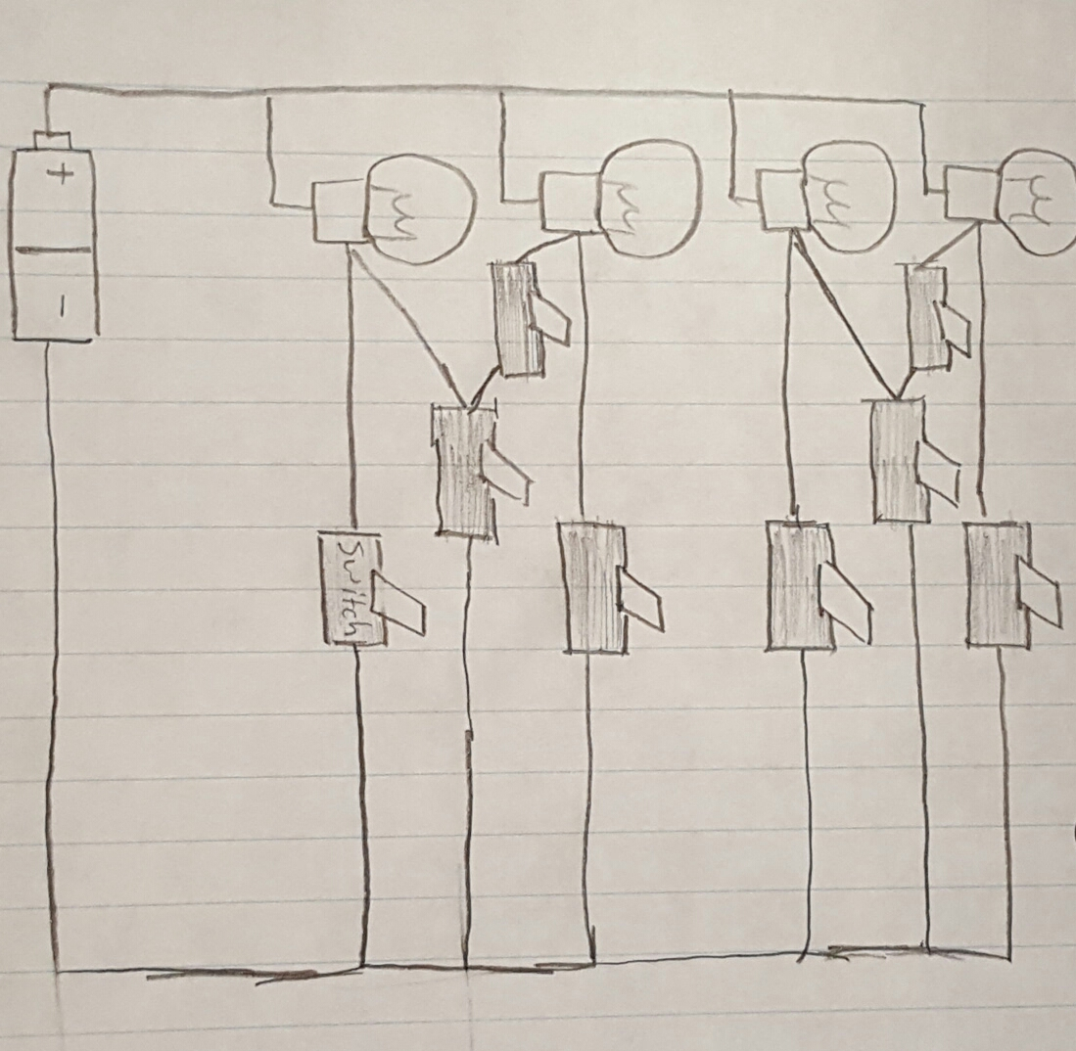
Prototype
This was our final circuit design. Each switch on the left most column. Two switches were required to create a pad that could light up two bulbs in one press. With two switches, the current can’t backtrack and light up more that one switch when a pad that is intended to light up a single bulb is pressed.

Slide 7
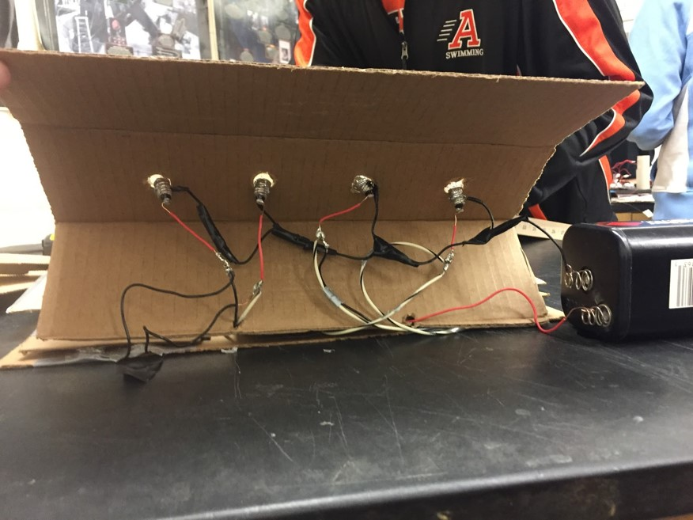
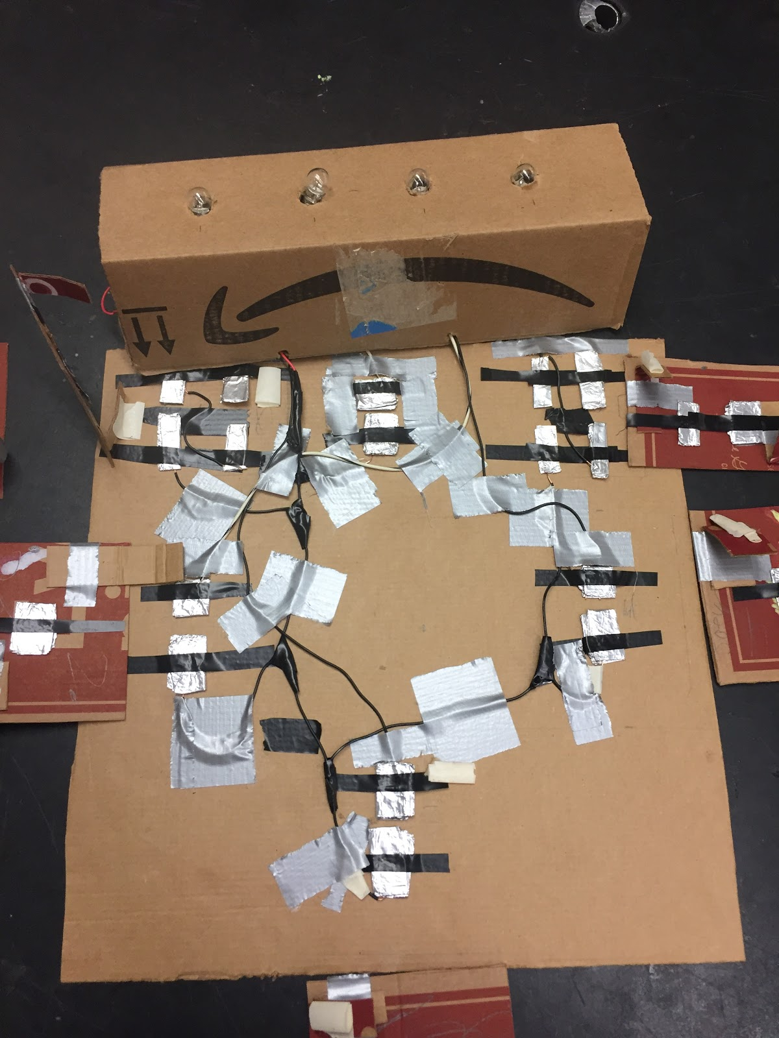
Refine
This shows our whole pad without all the individual dance pads. This shows the aluminum switches and the wiring of the whole pad.

Slide 8
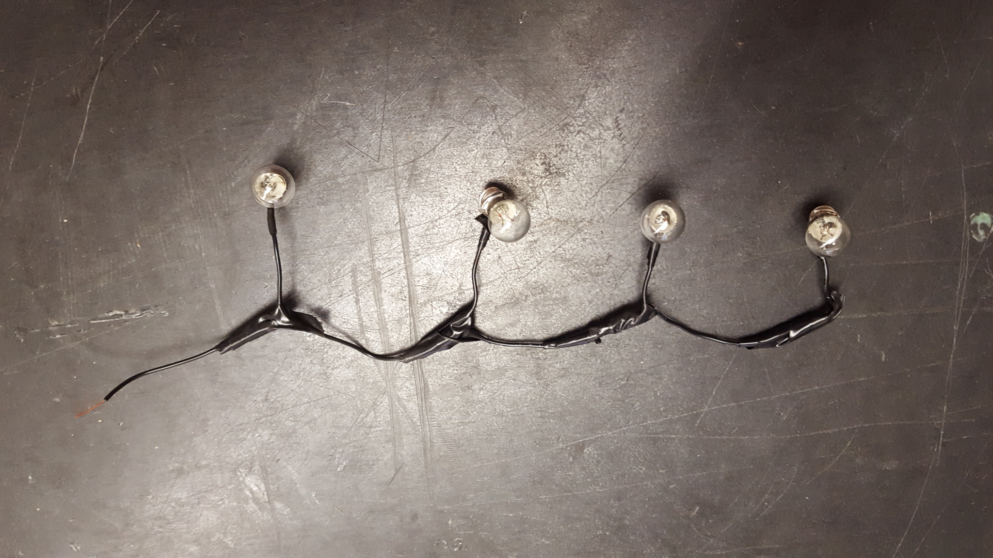
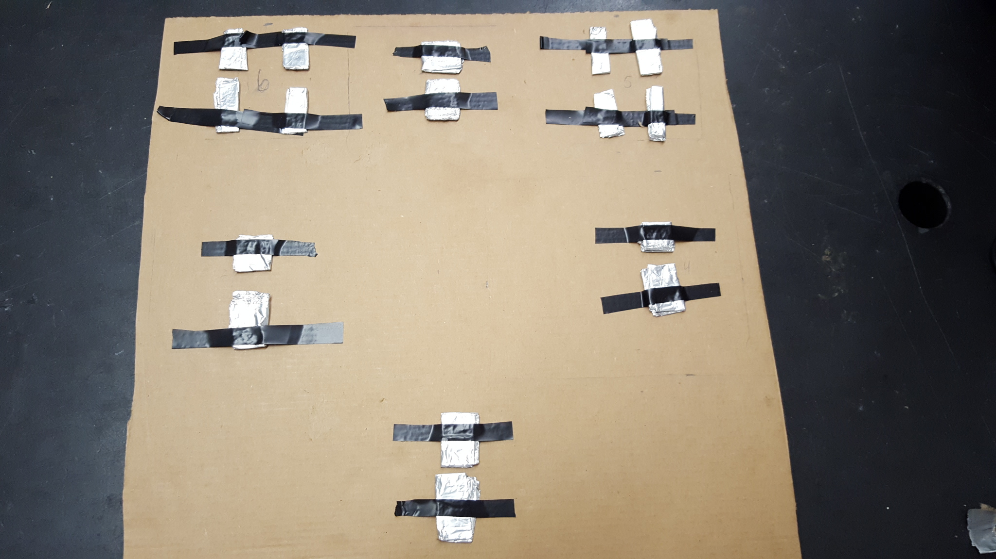
Refine cont.
This shows the pare parts of the pad including all the lightbulbs in a continuous wire and where the switches would be located.

Slide 9
Final
Video

